Slide 1
Financial Performance Dashboard Project
Objective: The goal of this Tableau project is to analyze financial performance across different countries, products, and time periods, using key financial metrics such as sales, profit, cost of goods sold (COGS), and discounts.
Columns Provided:
Segment Manufacturing Price COGS Year
Country Sale Price Profit
Product Gross Sales Date
Discount Band Discounts Month Number
Units Sold Sales Month Name
Problem Statement :
The goal of this Power BI Dashboard Project is to analyze the financial performance of a company using the provided Microsoft Sample Data.
To create a visually appealing dashboard that provides an overview of the company's financial metrics enabling stakeholders to make informed business decisions.

Slide 2
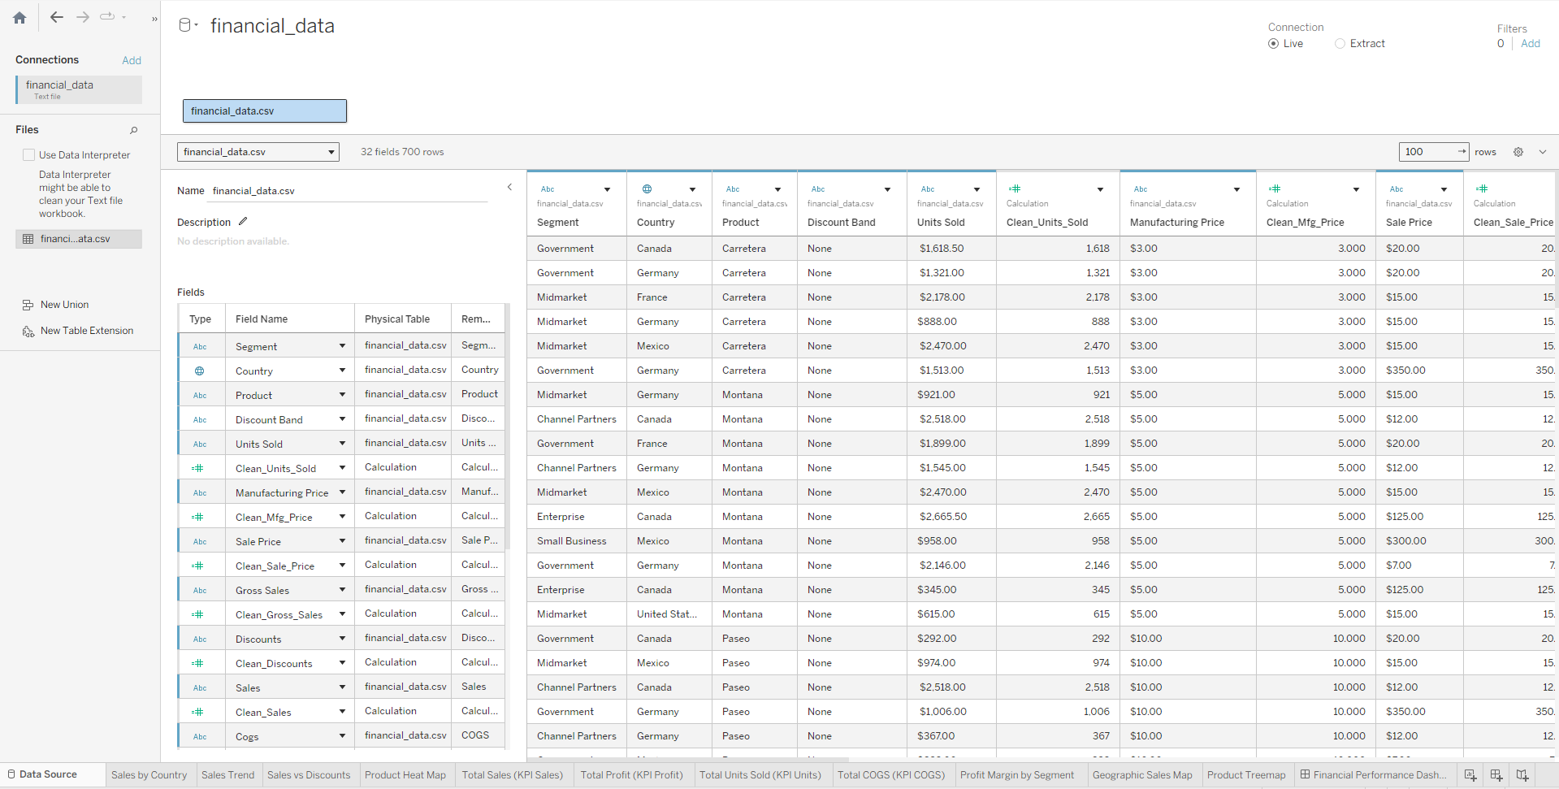
Dataset

Slide 3
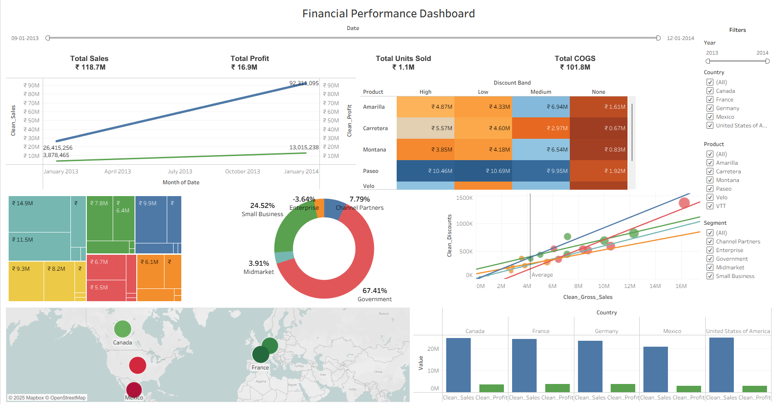

Slide 4
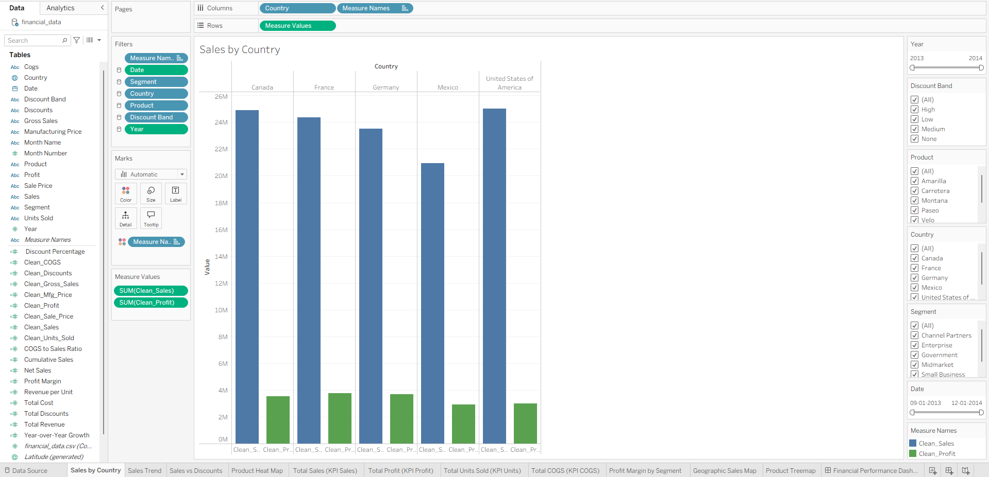
Sales by Country (Bar graph)

Slide 5
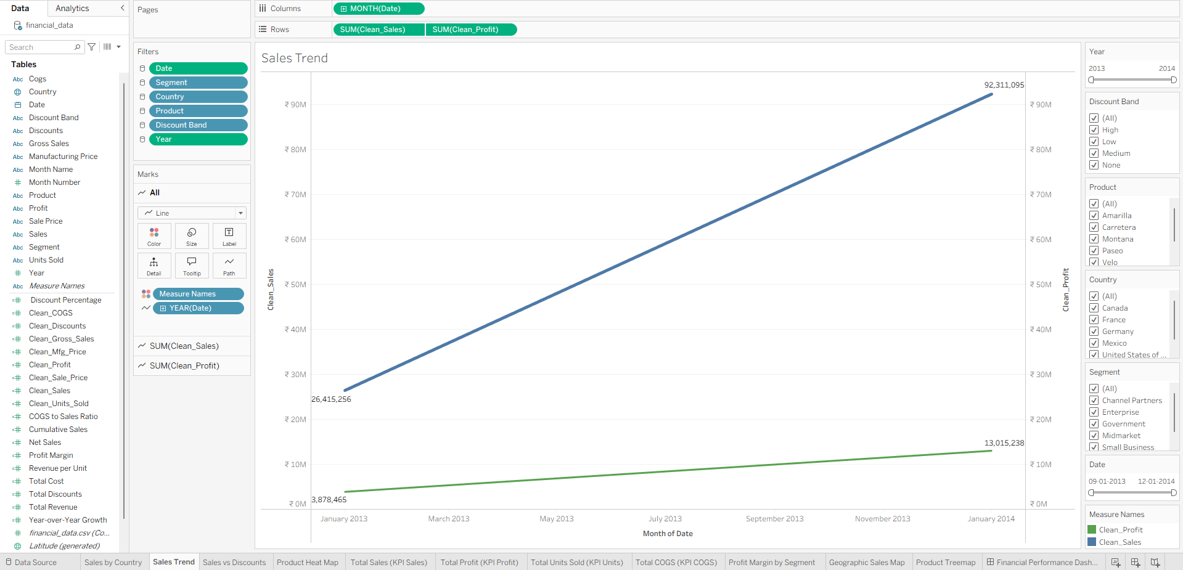
Sales Trend (Line Graph)

Slide 6
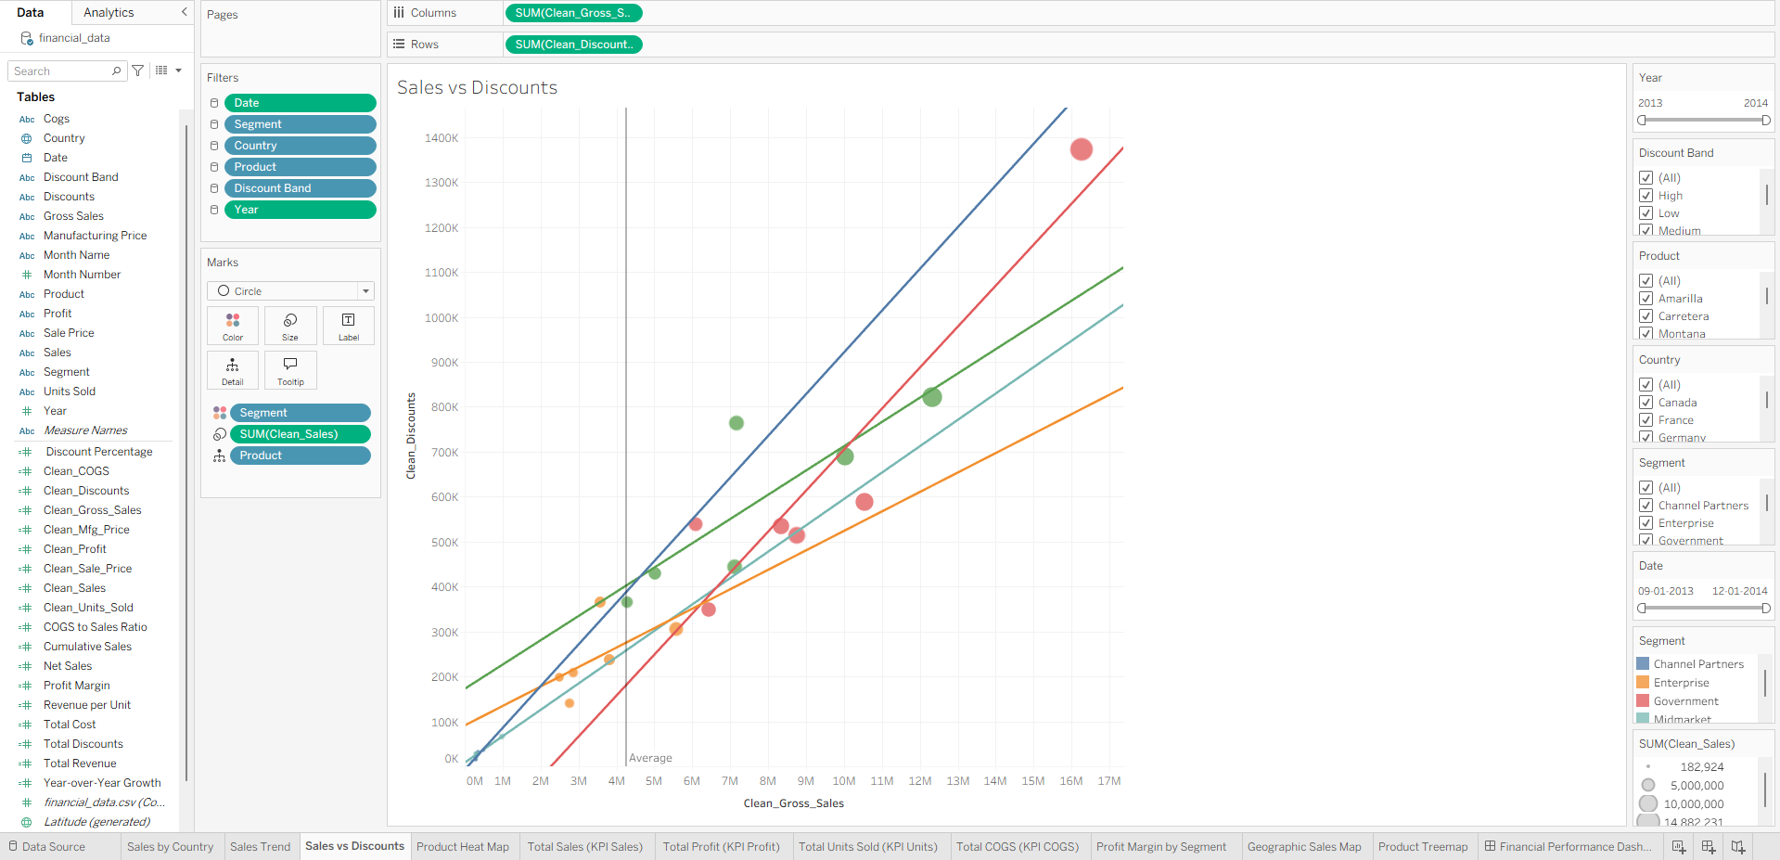
Sales vs Discounts (Scatter Plot)

Slide 7
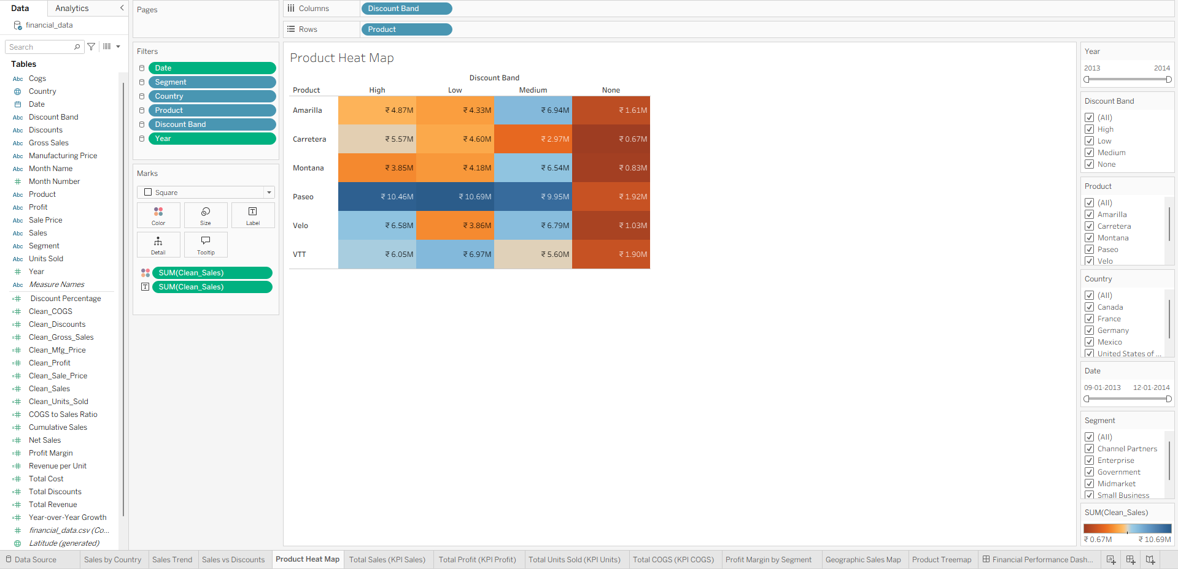
Sales by Product and Discount Band (Heat Map)

Slide 8
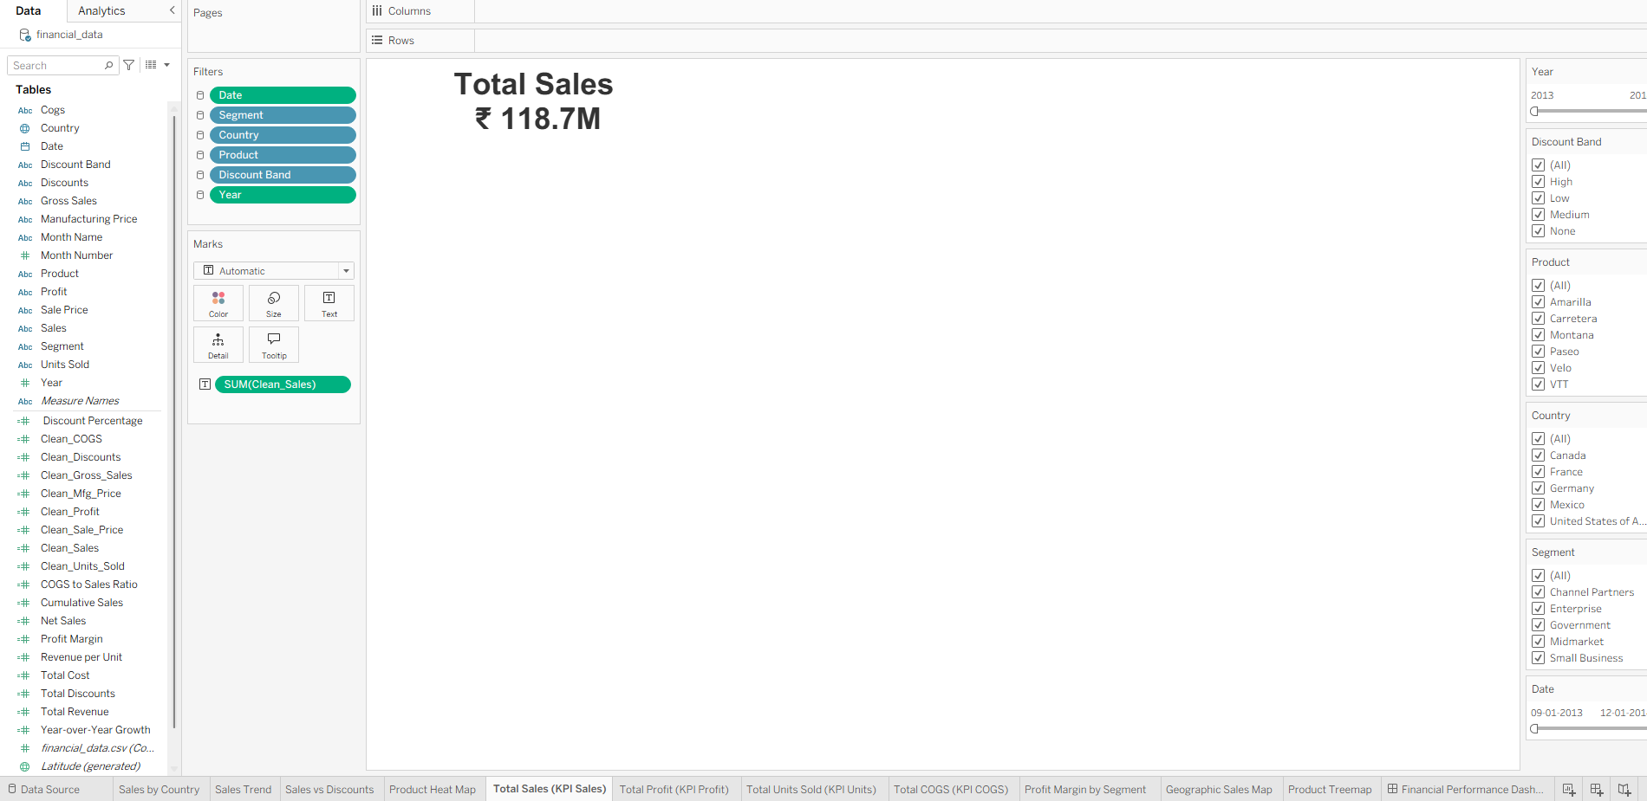
Total sales

Slide 9
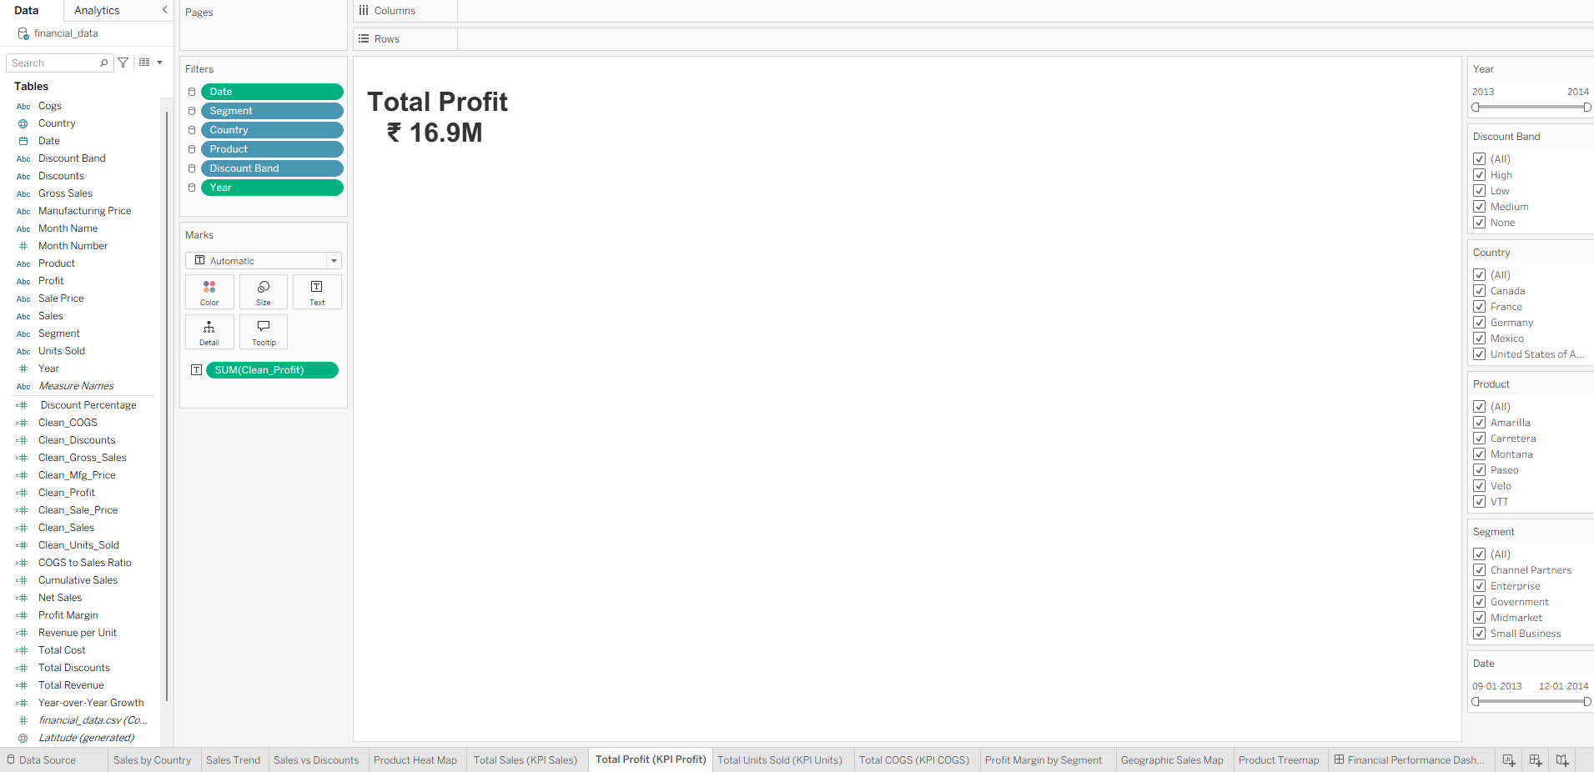
Total Profit

Slide 10
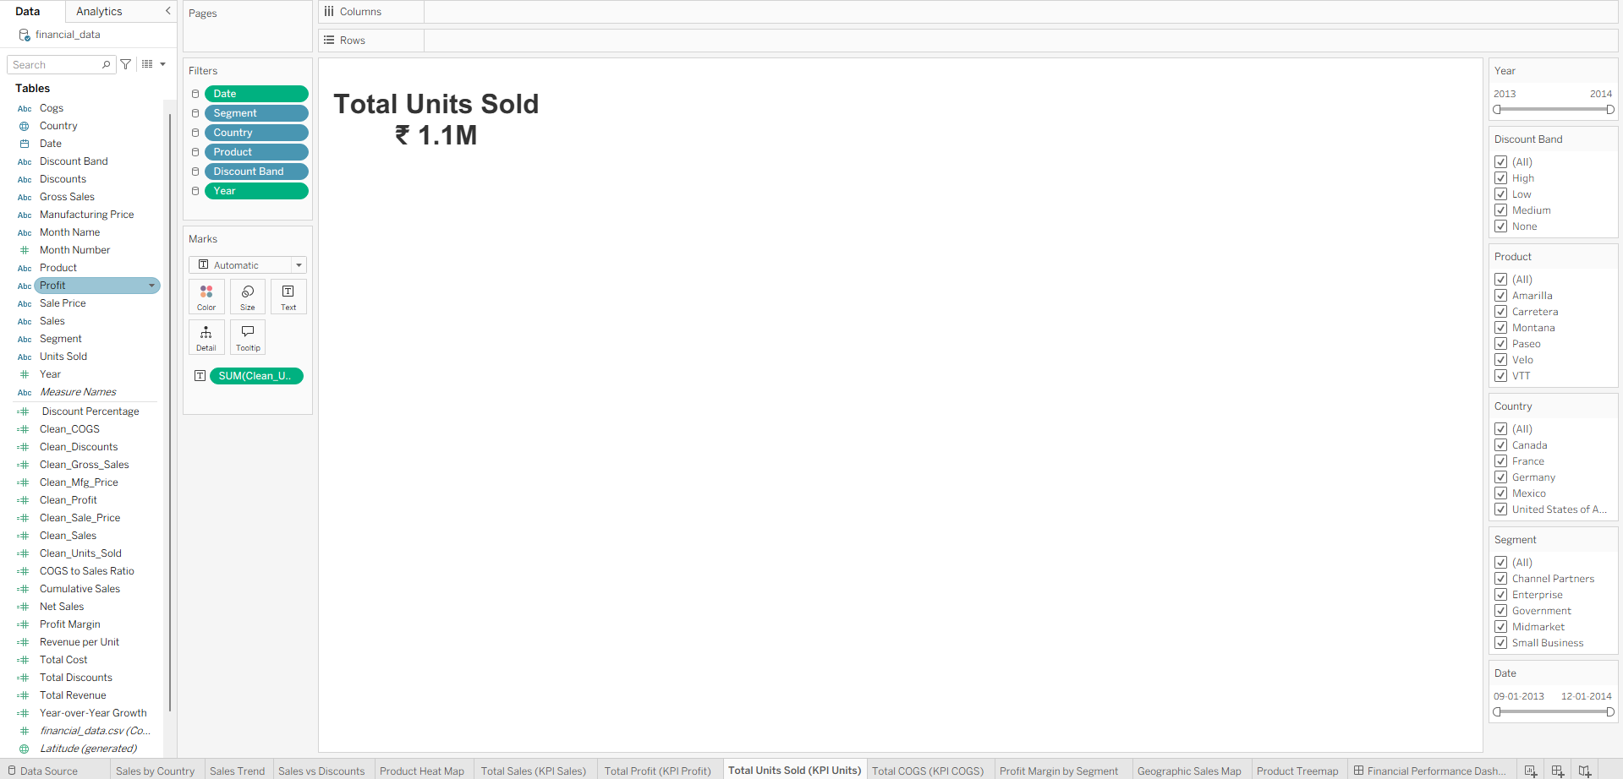
Total Units Sold

Slide 11
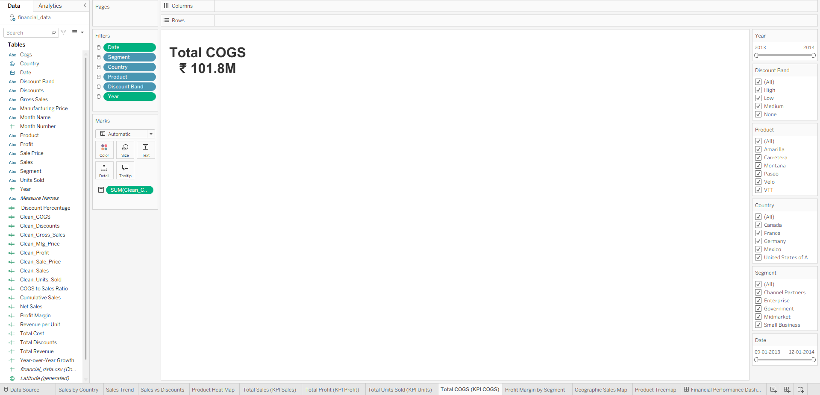
Total COGS

Slide 12
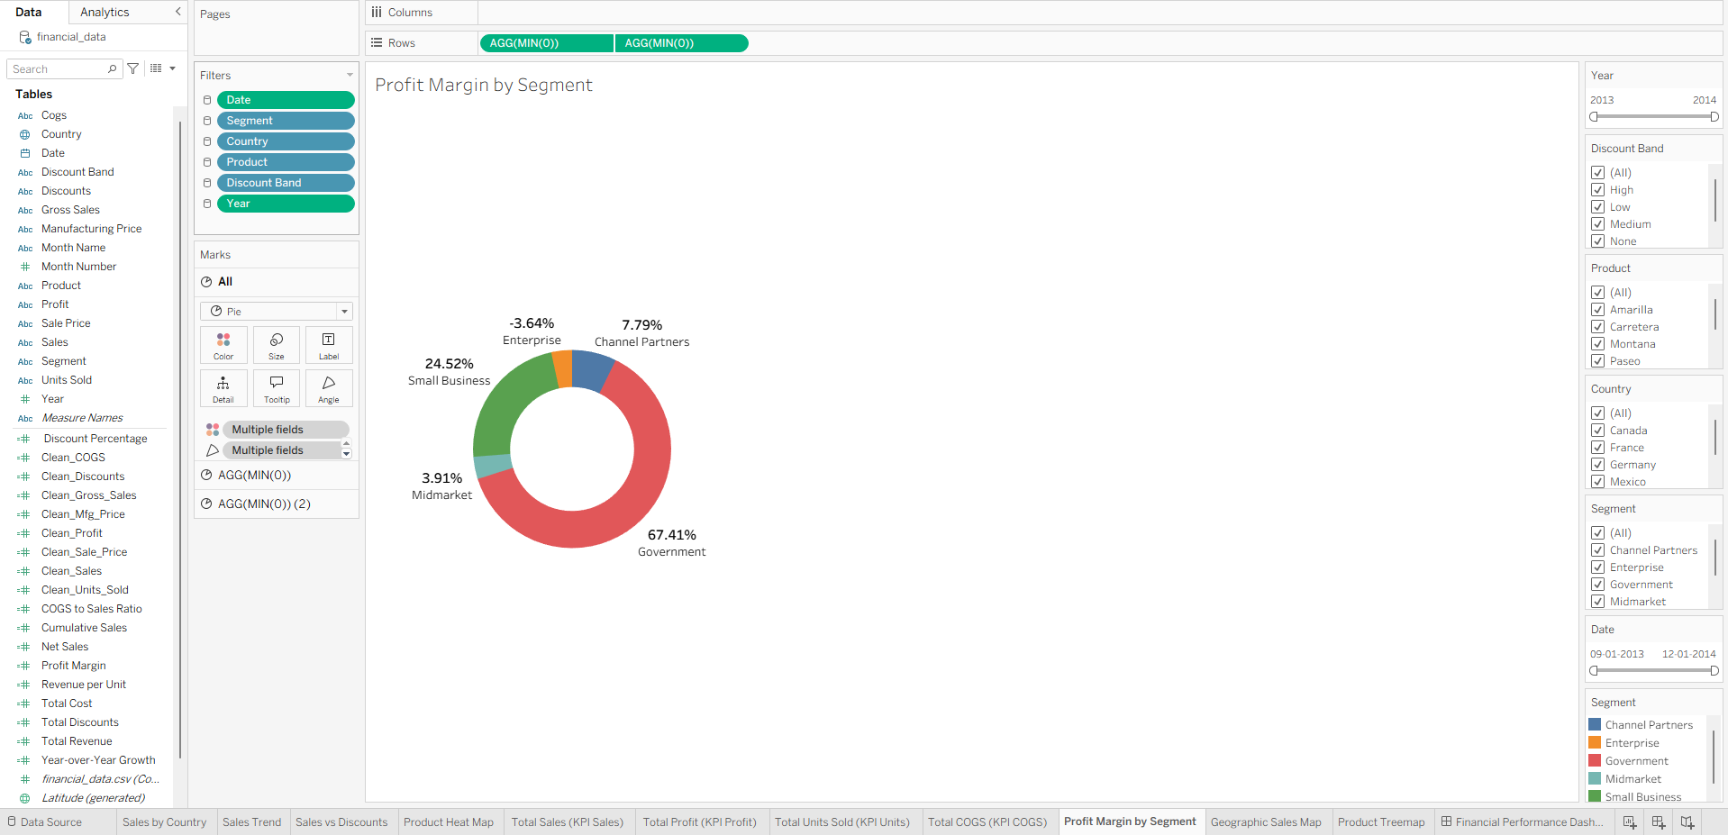
Profit Margin by Segment (Donut Chart)

Slide 13
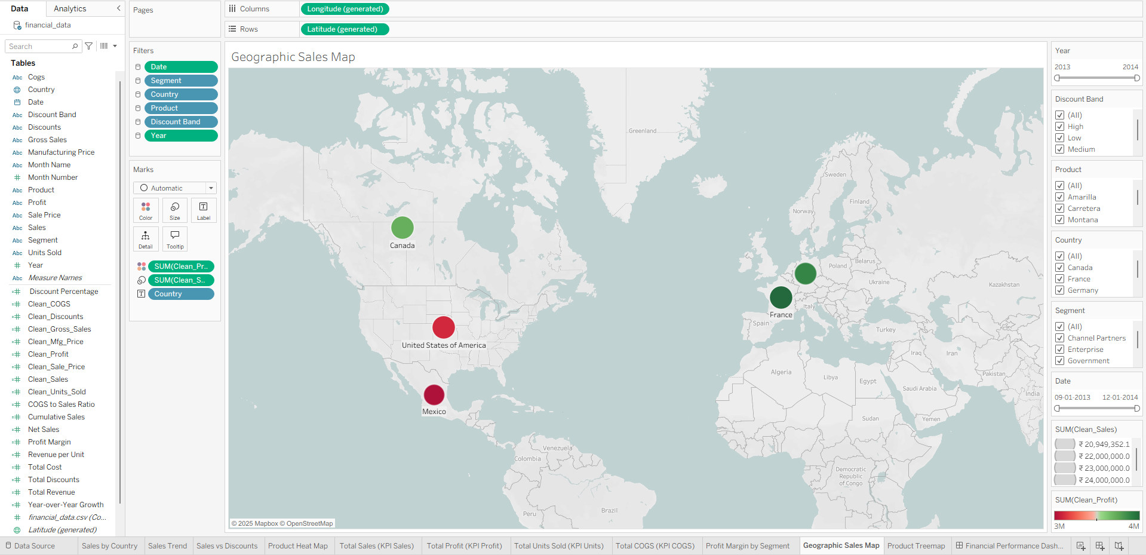
Geographic Sales Map

Slide 14
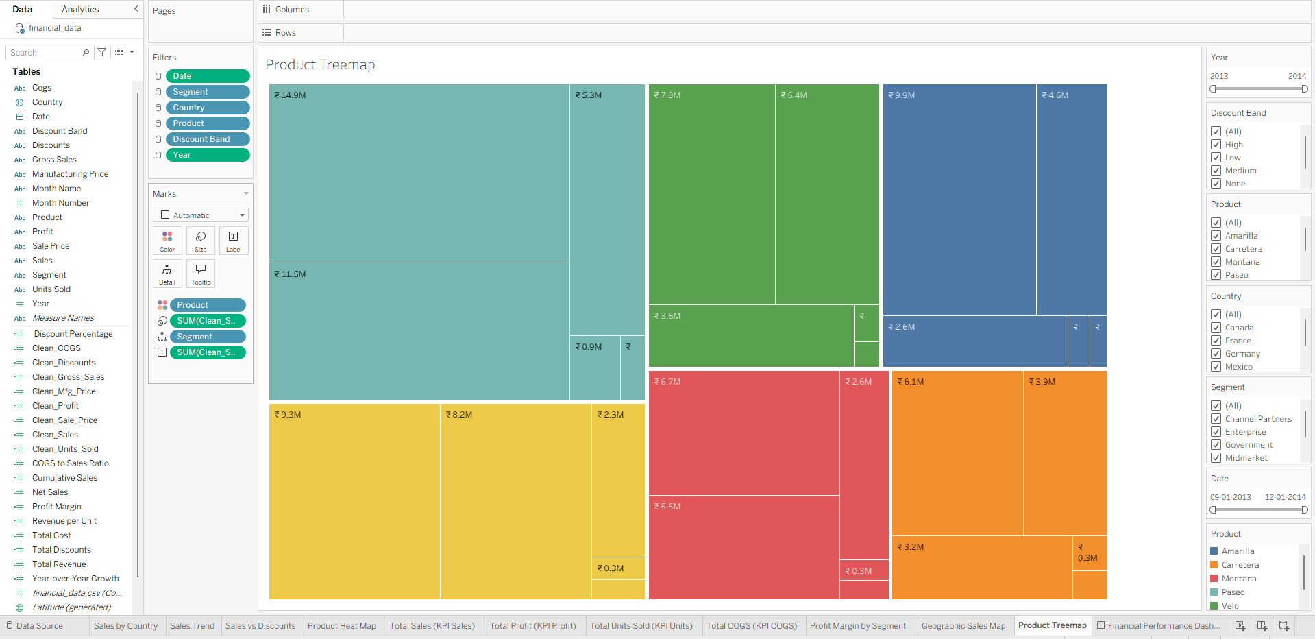
Product Contribution (Tree map)

